Slide 1
9-IBFE with Advection and Diffusion

Slide 2
2D Example of plate moving through concentration gradient
Please see 9-IBFE_TetherForceHalfPlate2D_advdiff
This example includes a flexible plate that moves up then down that is tethered to target points on the one half of its length.
A temperature (or concentration) gradient is considered that begins as a linear function of x with periodic boundary conditions.

Slide 3
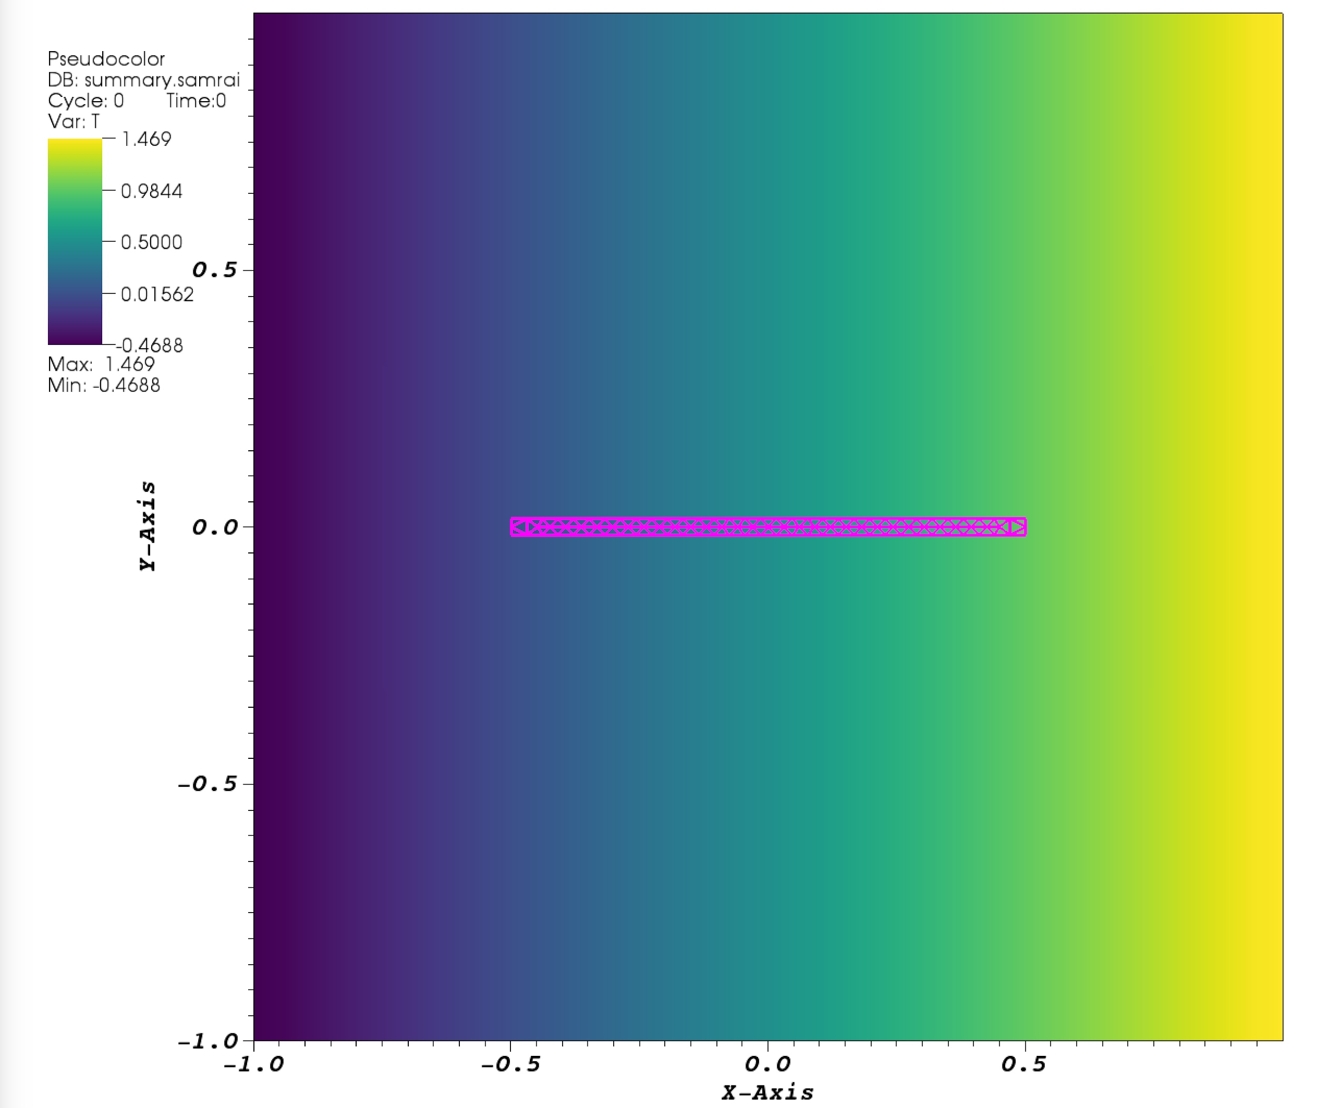
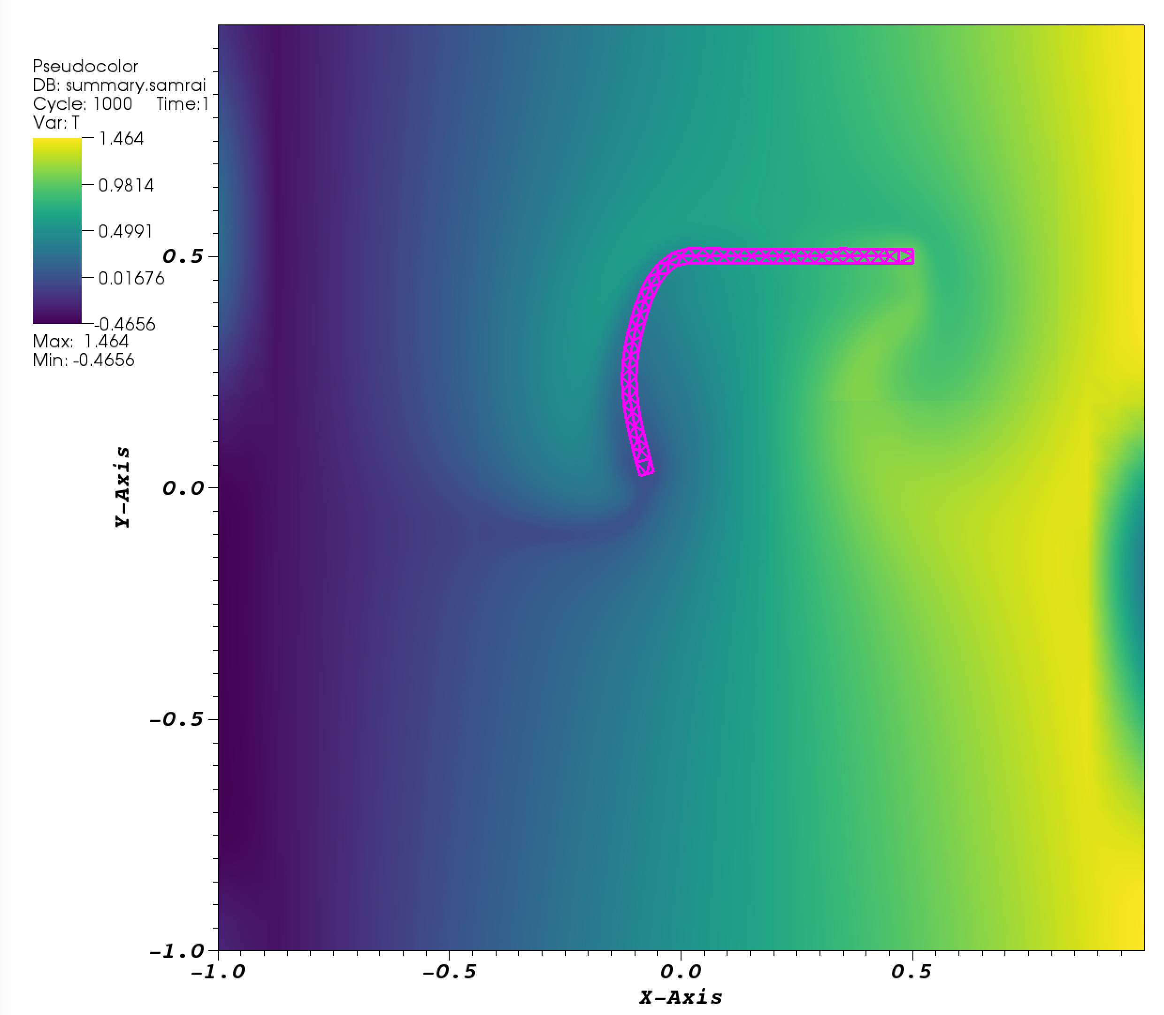
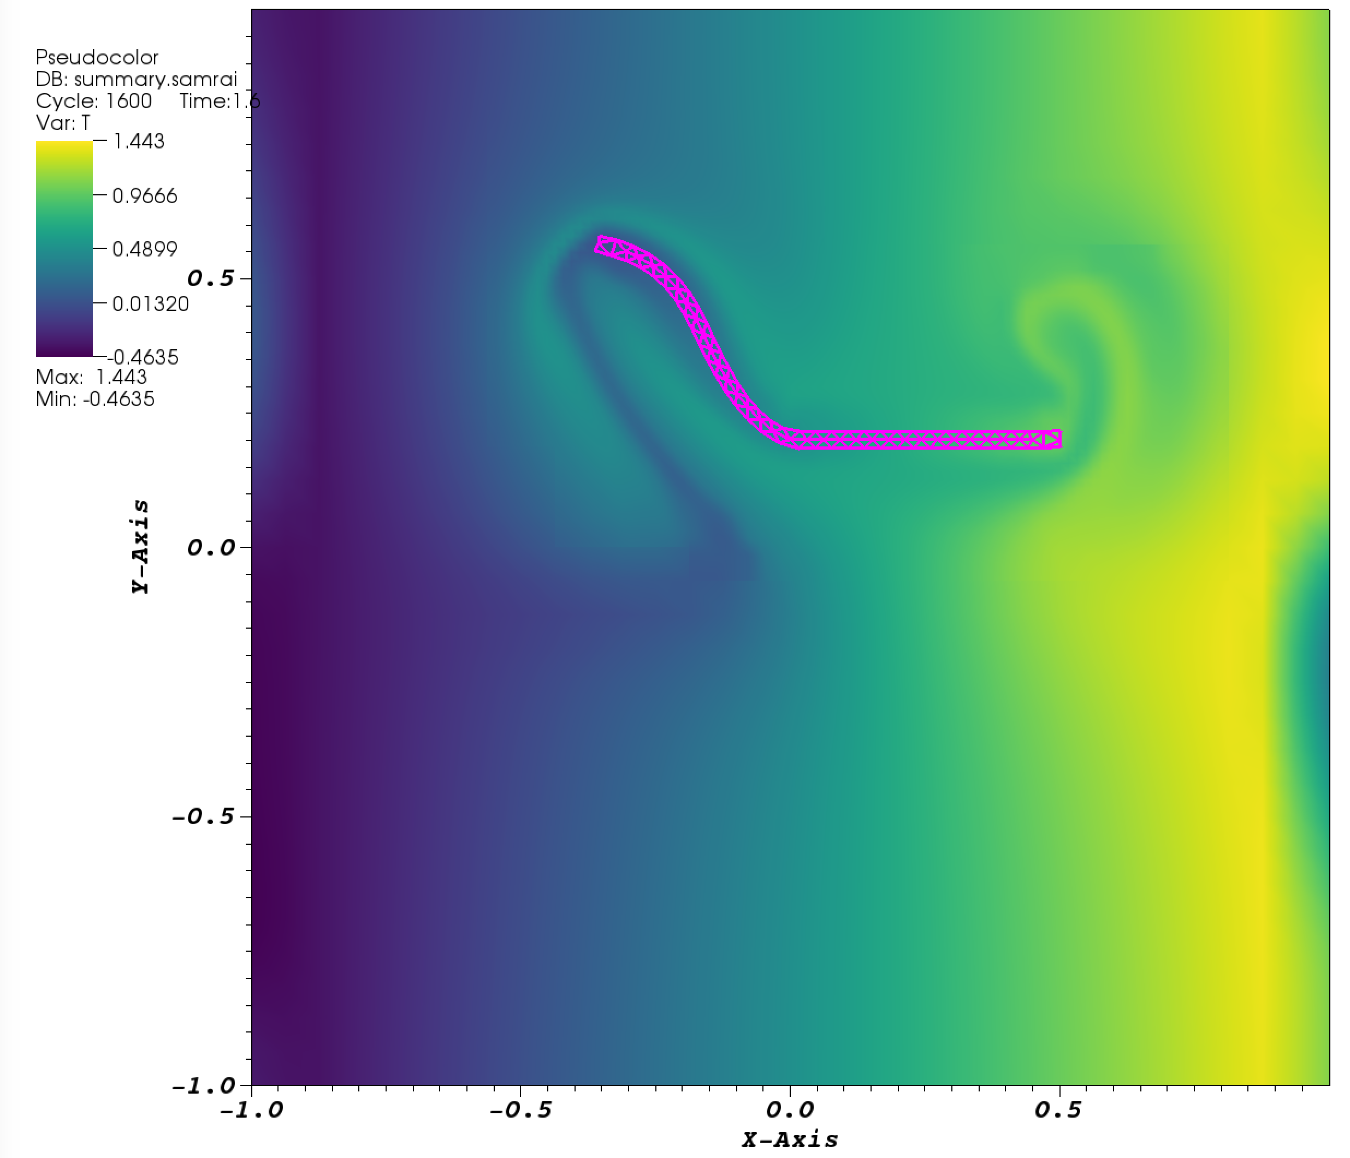
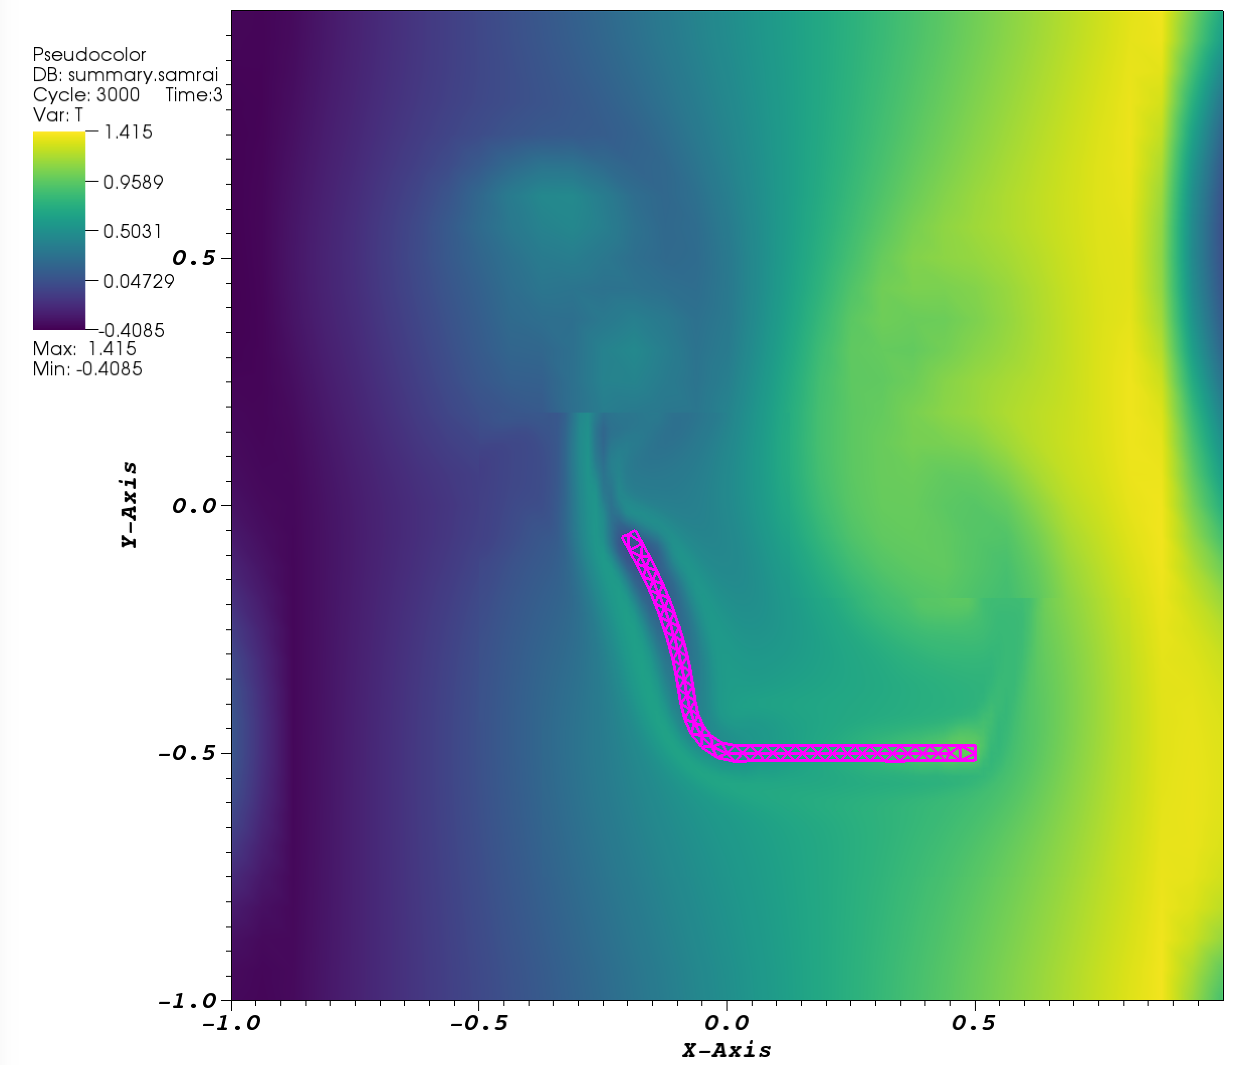
Snapshots from simulation

Slide 4
Updating IBFE examples for advection diffusion
This requires editing the main.C and input2d files.
This also requires some thought into the appropriate initial and boundary conditions.
The boundary conditions are set up the same way as the velocity boundary conditions (e.g. periodic or Robin boundary conditions).
In this example, the boundary conditions are periodic (overrides Robin) and the initial concentration is a linear function of x.

Slide 5
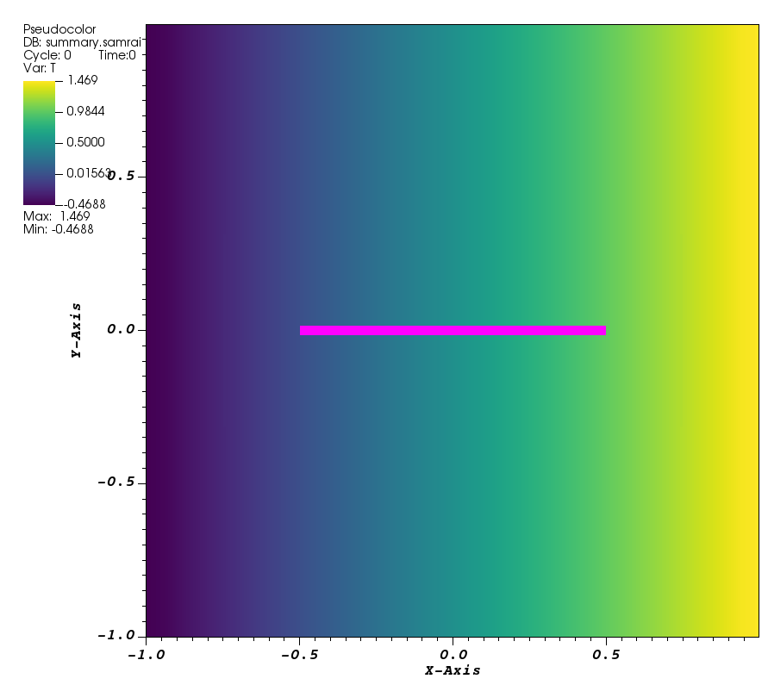
Temperature (or concentration) initial conditions
The temperature is a linear function of x which has an initial range of -0.5 to 1.5.
Recall that X_0 is the x-position.
TemperatureInitialConditions {
function = "0.5+X_0" //
}

Slide 6
Temperature (or concentration) boundary conditions
In the given example, the periodic boundary conditions override Robin.
CartesianGeometry {
domain_boxes = [ (0,0),(N - 1,N - 1) ]
x_lo = -.5*L,-.5*L
x_up = .5*L,.5*L
periodic_dimension = 1,1}

Slide 7
Temperature boundary conditions
But if periodic is turned off, the boundary conditions are fixed as
T=0.5+x on ∂Ω
TemperatureBcCoefs {
acoef_function_0 = "1.0"
acoef_function_1 = "1.0"
acoef_function_2 = "1.0"
acoef_function_3 = "1.0"
bcoef_function_0 = "0.0"
bcoef_function_1 = "0.0"
bcoef_function_2 = "0.0"
bcoef_function_3 = "0.0"
gcoef_function_0 = "0.5+X_0" //
gcoef_function_1 = "0.5+X_0" //
gcoef_function_2 = "0.5+X_0" //
gcoef_function_3 = "0.5+X_0" //
}

Slide 8

Review of Robin boundary conditions
Robin boundary conditions are a weighted combination of Dirichlet boundary conditions and Neumann boundary conditions.
If Ω is the domain on which the given equation is to be solved and ∂Ω denotes its boundary, the Robin boundary condition is:
for some non-zero constants a and b and a given function g defined on ∂Ω .

Slide 9

Example: Robin bc’s
In one dimension, if Ω = [0,1] , the Robin boundary condition becomes:
Notice the change of sign in front of the term involving a derivative. This is because the normal at x=0 points in the negative direction, while at x=1 it points in the positive direction.

Slide 10
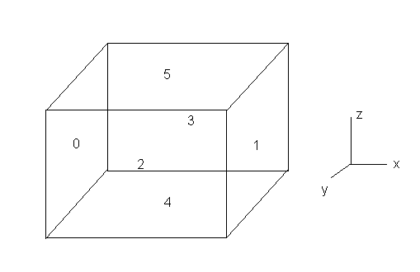
IBAMR boundary numbering
Look in the input2D/3D files.
2D: x_{left}=0, x_{right}=1, y_{bottom}=2, y_{top}=3
3D: add z_{bottom}=4, z_{top}=5

Slide 11
Changing an example for advection diffusion
main.C
Include headers for advection diffusion solver near top.
// Headers for application-specific algorithm/data structure objects
#include <ibamr/AdvDiffPredictorCorrectorHierarchyIntegrator.h>
#include <ibamr/AdvDiffSemiImplicitHierarchyIntegrator.h>

Slide 12
In main.C
Before you Configure the IBFE solver in main.C, add these lines (note they go after the pointers for load balancers and gridding algorithms).
const bool periodic_domain = grid_geometry->getPeriodicShift().min() > 0;
// Setup the advected and diffused quantity.
Pointer<CellVariable<NDIM,double> > T_var = new CellVariable<NDIM,double>("T");
adv_diff_integrator->registerTransportedQuantity(T_var);
adv_diff_integrator->setDiffusionCoefficient(T_var, input_db->getDouble("KAPPA"));
adv_diff_integrator->setInitialConditions(T_var, new muParserCartGridFunction("T_init", app_initializer->getComponentDatabase("TemperatureInitialConditions"), grid_geometry));
RobinBcCoefStrategy<NDIM>* T_bc_coef = NULL;
if (!periodic_domain)
{
T_bc_coef = new muParserRobinBcCoefs("T_bc_coef", app_initializer->getComponentDatabase("TemperatureBcCoefs"), grid_geometry);
adv_diff_integrator->setPhysicalBcCoef(T_var, T_bc_coef);
}
adv_diff_integrator->setAdvectionVelocity(T_var, navier_stokes_integrator->getAdvectionVelocityVariable());

Slide 13
In main.C
After you create the major algorithm and data objects that comprise the application (e.g. setting the solver_type, IBFE method, etc. add the following for the adv diff solver:
Pointer<Database> main_db = app_initializer->getComponentDatabase("Main");
Pointer<AdvDiffHierarchyIntegrator> adv_diff_integrator;
const string adv_diff_solver_type = main_db->getStringWithDefault("adv_diff_solver_type", "PREDICTOR_CORRECTOR");
if (adv_diff_solver_type == "PREDICTOR_CORRECTOR")
{
Pointer<AdvectorExplicitPredictorPatchOps> predictor = new AdvectorExplicitPredictorPatchOps("AdvectorExplicitPredictorPatchOps", app_initializer->getComponentDatabase("AdvectorExplicitPredictorPatchOps"));
adv_diff_integrator = new AdvDiffPredictorCorrectorHierarchyIntegrator("AdvDiffPredictorCorrectorHierarchyIntegrator", app_initializer->getComponentDatabase("AdvDiffPredictorCorrectorHierarchyIntegrator"), predictor);
}
else if (adv_diff_solver_type == "SEMI_IMPLICIT")
{
adv_diff_integrator = new AdvDiffSemiImplicitHierarchyIntegrator("AdvDiffSemiImplicitHierarchyIntegrator", app_initializer->getComponentDatabase("AdvDiffSemiImplicitHierarchyIntegrator"));
}
else
{
TBOX_ERROR("Unsupported solver type: " << adv_diff_solver_type << "\n" <<
"Valid options are: PREDICTOR_CORRECTOR, SEMI_IMPLICIT");
}
navier_stokes_integrator->registerAdvDiffHierarchyIntegrator(adv_diff_integrator);

Slide 14
Input2d
Add a diffusion coefficient to the physical parameters.
KAPPA = 1.0e-6 // temperature diffusion coefficient
Add these to the bottom of the list of solver parameters.
ADV_DIFF_SOLVER_TYPE = "SEMI_IMPLICIT" // the advection-diffusion solver to use (PREDICTOR_CORRECTOR or SEMI_IMPLICIT)
ADV_DIFF_NUM_CYCLES = 2 // number of cycles of fixed-point iteration
ADV_DIFF_CONVECTIVE_TS_TYPE = "MIDPOINT_RULE" // convective time stepping type
ADV_DIFF_CONVECTIVE_OP_TYPE = "PPM" // convective differencing discretization type
ADV_DIFF_CONVECTIVE_FORM = "ADVECTIVE" // how to compute the convective terms
DT_MAX = 0.1 // maximum timestep size

Slide 15
input2d
Add temperature initial and boundary conditions after the list of velocity initial and boundary conditions.
TemperatureInitialConditions {
//function = "0.5*(tanh(80.0*(-X_1-0.15))+1)"
//function = "(0.5*(tanh(80.0*(-X_1-0.15))+1))*(0.5*(tanh(80.0*(X_0+0.115))+1))*(0.5*(tanh(80.0*(-X_0+0.115))+1))"
function = "0.5+X_0" //
//function = "0.5"
}
TemperatureBcCoefs {
acoef_function_0 = "1.0"
acoef_function_1 = "1.0"
acoef_function_2 = "1.0"
acoef_function_3 = "1.0"
bcoef_function_0 = "0.0"
bcoef_function_1 = "0.0"
bcoef_function_2 = "0.0"
bcoef_function_3 = "0.0"
gcoef_function_0 = "0.5+X_0" //
gcoef_function_1 = "0.5+X_0" //
gcoef_function_2 = "0.5+X_0" //
gcoef_function_3 = "0.5+X_0" //
}

Slide 16
input2d
Add settings for advection diffusion solver.
AdvDiffPredictorCorrectorHierarchyIntegrator {
start_time = START_TIME
end_time = END_TIME
grow_dt = GROW_DT
convective_difference_form = ADV_DIFF_CONVECTIVE_FORM
cfl = CFL_MAX
dt_max = DT_MAX
tag_buffer = TAG_BUFFER
enable_logging = ENABLE_LOGGING
AdvDiffPredictorCorrectorHyperbolicPatchOps {
compute_init_velocity = TRUE
compute_half_velocity = TRUE
compute_final_velocity = FALSE
extrap_type = "LINEAR"
}
HyperbolicLevelIntegrator {
cfl = CFL_MAX
cfl_init = CFL_MAX
lag_dt_computation = TRUE
use_ghosts_to_compute_dt = FALSE
}}

Slide 17
input2d
Add settings for advection diffusion solver continued.
AdvDiffSemiImplicitHierarchyIntegrator {
start_time = START_TIME
end_time = END_TIME
grow_dt = GROW_DT
num_cycles = ADV_DIFF_NUM_CYCLES
convective_time_stepping_type = ADV_DIFF_CONVECTIVE_TS_TYPE
convective_op_type = ADV_DIFF_CONVECTIVE_OP_TYPE
convective_difference_form = ADV_DIFF_CONVECTIVE_FORM
cfl = CFL_MAX
dt_max = DT_MAX
tag_buffer = TAG_BUFFER
enable_logging = ENABLE_LOGGING
}

Slide 18
Rescaling kappa_spring and the elastic modulus
F=kx
k_new = (k_old*(F_new/F_old))*(ds_old/ds_new)
F ~ rho*L*U^2
Elastic modulus – try leaving it the same. Scale mu and beta with e.
NU=0.3
E_STEM=1.0e7
E_LEAF=1.0e7
MU_LEAF = E_LEAF/(2.0*(1.0+NU))
MU_STEM = E_STEM/(2.0*(1.0+NU))
BETA_STEM = E_STEM*NU/((1.0 + NU)*(1.0 - 2.0*NU))
BETA_LEAF = E_LEAF*NU/((1.0 + NU)*(1.0 - 2.0*NU))

